Slide 1
IBM University Engagement Project Submission
“Exploring the Power of Agentic AI with IBM Granite and LangFlow”

Slide 2

Project Tile – Fitness Buddy: A Multi-Agent AI Fitness Assistant
Domain of Project – Healthcare
Student Name | Recent Passport Photo | Email ID | Mobile number [WhatsApp]
Manisha Angel Katragadda |  | manishakatragadda2835@gmail.com | 8919122761

Slide 3
Problem Statement -
Problem Statement : Fitness Buddy
The Challenge
In today’s fast-paced world, many individuals struggle to maintain a healthy lifestyle due
to lack of personalized guidance, time constraints, and inconsistent motivation. Traditional fitness
solutions often require expensive subscriptions, in-person consultations, or rigid schedules that don't
adapt to personal preferences or daily routines.
The Objective
Build an AI-powered Fitness Buddy that provides personalized fitness guidance, lifestyle support, and basic nutrition advice to help users stay healthy and active anytime. The solution should:
Personalized Workouts – Recommend home exercises based on fitness level, goals, and available time.
Conversational Coaching – Offer real-time guidance through an interactive chatbot.
Motivation & Habit Building – Provide daily tips, reminders, and encouragement for consistency.
Basic Nutrition Support – Suggest simple, healthy meal ideas aligned with fitness goals.
Progress Tracking – Enable users to log workouts and receive feedback on performance.
Multi-Agent System –
Workout Recommendation Agent (generates personalized exercise routines)
Motivation & Habit Agent (provides reminders and encouragement)
Nutrition Suggestion Agent (offers simple meal guidance)
Progress Tracking Agent (monitors activity and provides feedback)
Visualization Dashboard – Display workout history, consistency trends, calories burned, and progress toward fitness goals.

Slide 4
Proposed Solution -
Proposed Solution: AI-Powered Fitness Buddy
The proposed solution is a multi-agent AI-powered Fitness Buddy built using LangFlow, IBM watsonx.ai, and Granite models to deliver personalized fitness guidance, lifestyle support, and basic nutrition advice. It aims to address common challenges such as lack of consistency, improper workout planning, and limited access to reliable fitness guidance through an intelligent, adaptive, and user-friendly system.
The solution leverages a Retrieval-Augmented Generation (RAG) approach to fetch accurate fitness and nutrition-related information from trusted sources. This data is embedded and stored in a vector database, enabling efficient retrieval and real-time generation of relevant recommendations tailored to each user’s profile, goals, and preferences.
The system includes four key agents: • Workout Recommendation Agent – suggests personalized home workouts based on fitness level and goals • Motivation & Habit Agent – provides daily tips, reminders, and encouragement • Nutrition Suggestion Agent – offers simple meal guidance aligned with fitness goals • Progress Tracking Agent – monitors user activity and provides feedback
The solution also includes a user-friendly dashboard (built using Streamlit or React) that visualizes workout history, consistency trends, calories burned, and progress toward fitness goals, helping users stay informed and motivated.
LangFlow is used to orchestrate agent workflows and ensure smooth interaction between components, while IBM watsonx.ai provides scalable model deployment, embeddings, and AI governance. Granite models power reasoning, personalization, and conversational capabilities.
Overall, the Fitness Buddy acts as an intelligent virtual coach that supports users in building sustainable fitness habits, improving overall well-being, and achieving their health goals through personalized insights, continuous feedback, and real-time assistance.

Slide 5
Technology Used
- IBM watsonx Orchestrate – Core platform used to build and deploy the Fitness Buddy agent, enabling structured multi-agent interactions for workout, nutrition, motivation, and tracking.
- IBM Granite Model– Provides natural language understanding and response generation, enabling personalized fitness guidance and conversational interaction.
- Flask (Python) – Lightweight backend framework used to serve the web application and integrate the watsonx Orchestrate chat widget.
- HTML/CSS (Frontend)– Simple user interface to interact with the Fitness Buddy agent via the embedded chat widget.
- IBM Cloud – Hosts and manages the watsonx Orchestrate service, ensuring scalability and reliability.

Slide 6
Langflow component Used -
- Chat Input – Users enter fitness goals or queries through a web interface (text-based input).
- LangFlow Workflow – Used to visually design and structure the multi-agent logic, enabling coordination between Workout, Nutrition, Motivation, and Tracking agents.
- IBM watsonx Orchestrate Agent – Executes the designed workflow and manages interactions between the different functional agents.
- IBM Granite Model – Powers natural language understanding and generates personalized fitness responses.
- Chat Output– Displays structured responses including workout plans, nutrition suggestions, motivational messages, and progress insights.
- Flask Backend– Hosts the application and connects the frontend with the watsonx Orchestrate service.
- Frontend (HTML/CSS) – Provides a simple user interface with an embedded chat widget.

Slide 7
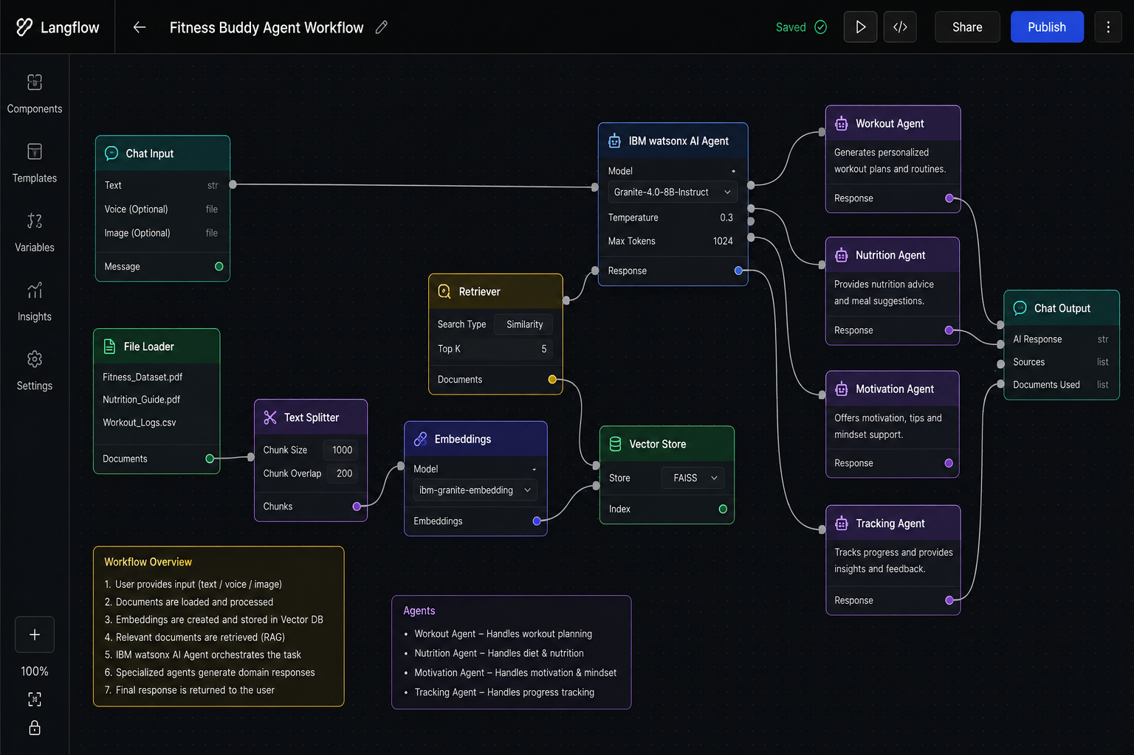
Langflow workflow -

Slide 8
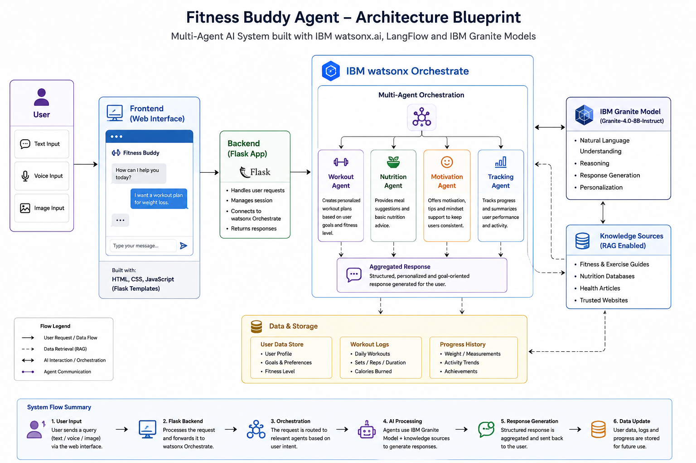
Architecture blueprint

Slide 9

Role of Agentic AI in the solution
🤖 Role of Agentic AI in Fitness Buddy Agent
Agentic AI enables the Fitness Buddy to function as an intelligent system by organizing responses through a structured multi-agent design rather than a single monolithic chatbot.
Using IBM watsonx Orchestrate and IBM Granite models, the system coordinates multiple functional agents—Workout, Nutrition, Motivation, and Tracking—to generate well-structured and goal-oriented responses.
Each agent is responsible for a specific task:
- The Workout Agent generates exercise plans
- The Nutrition Agent suggests basic meal guidance
- The Motivation Agent provides encouragement
- The Tracking Agent summarizes user progress based on input
These agents work together within a single workflow, ensuring that responses are organized, relevant, and aligned with the user’s fitness goals.
Agentic AI in this project introduces **task specialization and structured reasoning**, allowing the system to break down user queries into meaningful components and respond in a more organized and helpful way.
Overall, Agentic AI enhances the Fitness Buddy by making it more structured, modular, and user-focused—acting as a smart virtual fitness assistant that delivers clear and actionable guidance.

Slide 10
Novelty and Uniqueness
The Fitness Buddy stands out by leveraging a structured multi-agent design combined with modern AI capabilities to deliver organized and user-focused fitness guidance.
- Multi-Agent Intelligence – Instead of a single chatbot, the system uses multiple specialized agents (Workout, Nutrition, Motivation, Tracking) that work together to generate structured and relevant responses.
- Structured Response Design– Each agent contributes a specific part of the output, resulting in clear, well-organized fitness plans, suggestions, and feedback.
- Input-Based Personalization– Recommendations are tailored based on user-provided inputs such as fitness goals, preferences, and activity level.
- Context-Aware Interaction– The system understands user queries within a single interaction and generates responses that align with the user’s intent.
- Holistic Fitness Support– Covers multiple aspects of fitness, including workouts, basic nutrition guidance, and motivation, providing a more complete user experience.
- Scalable Architecture – Built using IBM watsonx Orchestrate and IBM Granite models, ensuring a reliable and extensible AI-powered system.

Slide 11
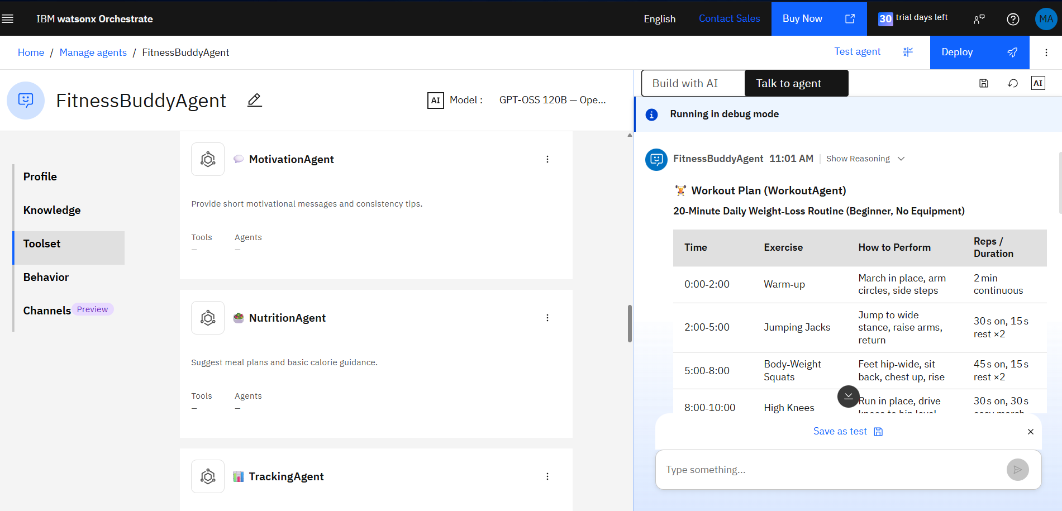
Screenshots-

Slide 12
Git Hub Link
https://github.com/KMA70/Fitness_Buddy_Agent
·
·
·

Slide 13
Future Scope
- Gamification & Reward System
Introduce features such as streak tracking, achievement badges, and reward mechanisms to improve user engagement and consistency. This can help users stay motivated and build long-term fitness habits.
-Adaptive Personalized AI Coach
Enhance the system with learning capabilities that analyze user inputs and interactions over time to dynamically refine workout plans and recommendations.
- Social & Community Features
Enable users to participate in fitness challenges, share progress, and interact with others through leaderboards or group activities, encouraging accountability and motivation.
- Injury Prevention & Recovery Guidance
Incorporate guidance for warm-ups, cooldowns, and recovery routines. Future versions could also detect potential overtraining patterns and suggest rest or lighter workouts.
·

Slide 14
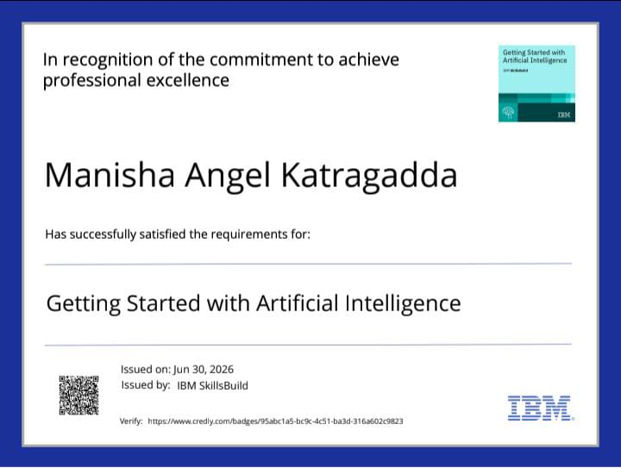
Certificates Earned:

Slide 15
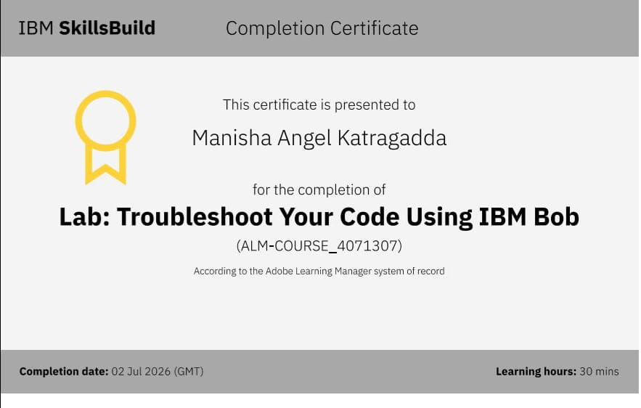
Certificates Earned:​

Slide 16


